Slide 1

Strength to Strength through
Professional
Learning Communities
Archdiocese of Seattle
January 2015

Slide 2

Targets
Making the case
Common definition
Challenges and Opportunities
Future dates and tools

Slide 3
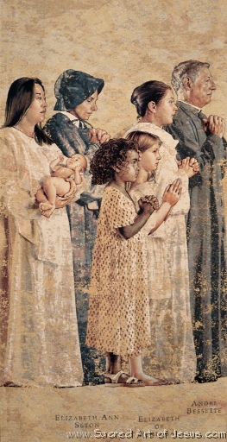
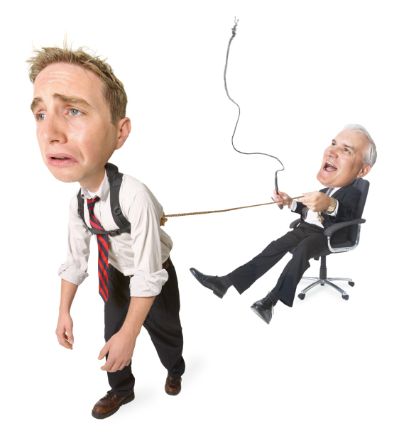

Roles as defined by the Catholic Conference
Notes:
Before we even begin, let talks about your many roles…if you look at the condensed view of our roles – based on the Catholic Conference – give the percentage of time you spend in each of these roles?
Spiritual Leader
Managerial Leader
Academic Leader
What are some hopes as you reflect on this?

Slide 4
Time?

Slide 5
Reality?

Slide 6
Diagnosis
Purpose of schooling
Role of the principal
Role of the teacher

Slide 7

Purpose of Schooling
…to ensure all levels of learning for all students. (Dufour and Dufour, 2012)
AND…
…to help our students fall in love with Jesus and the Church Community, and actively participate in discovering and building the Kingdom of God. (Archdiocese of Seattle, Religion Standards, 2014)
AND…
“at least as academically distinguished as that given in the other schools of the region”.
Renewing Our Commitment to Catholic Elementary and Secondary Schools in the Third Millennium (2005)

Slide 8
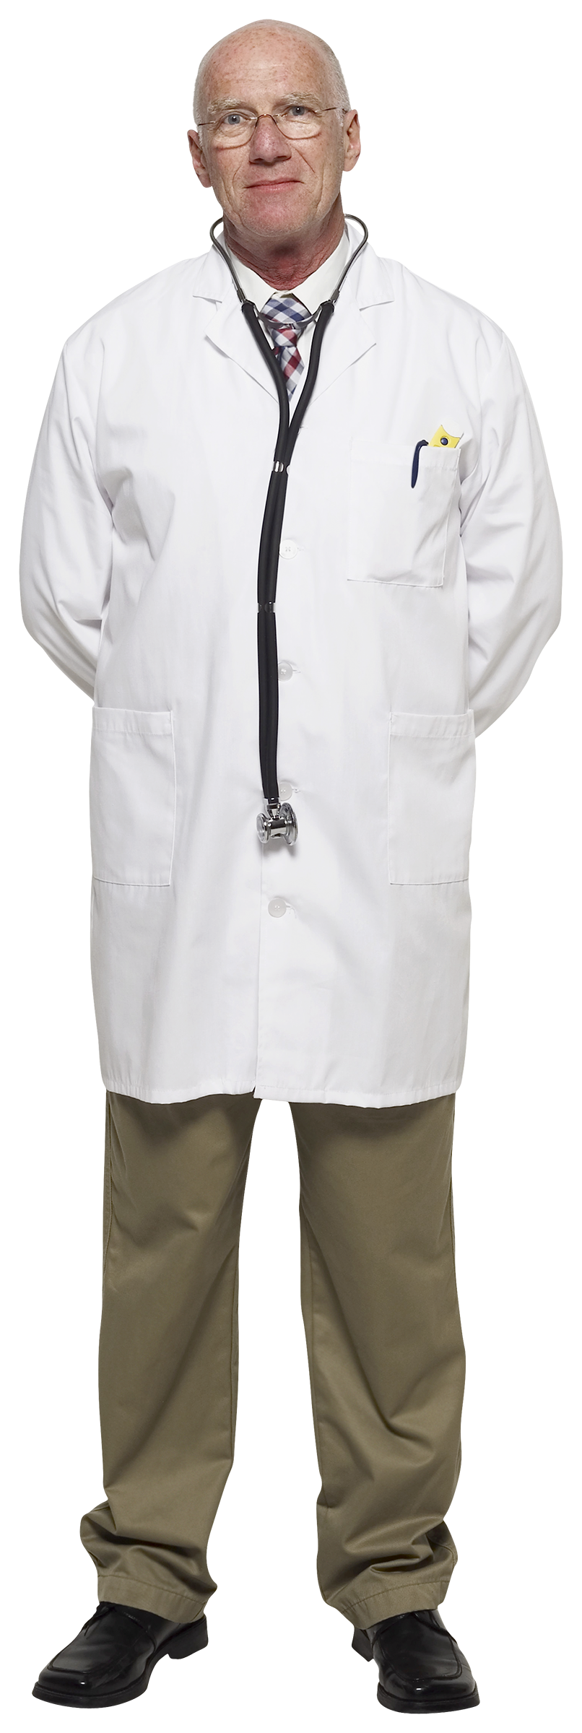
Role of the principal?
“Middle managers who serve as a conduit of employee improvement…”
(Lam, 2012)
“…leaders who rally stakeholders around a shared vision”
(Dufour and Dufour, 2012)
“…a curator of positive contagion” – facilitating the spread!” (Fullan, 2014)
Notes:
one who models learning, but also shapes the conditions for all to learn on a continuous basis.”

Slide 9
Role of the teacher?
What is it we want our students to know?
How will we teach it?
How will we know if our students are learning?
How will we respond when student do not learn?
How will we enrich and extend the learning for students who are proficient?

Slide 10
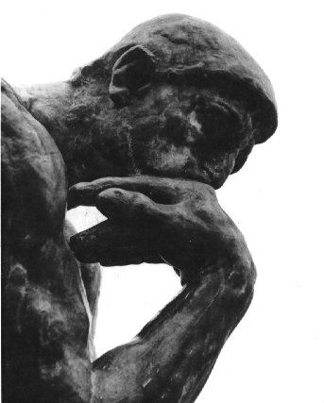
How do you define PLC?
http://www.designthinkingblog.com/wp-content/uploads/2010/05/thinking.gif
Notes:
Principals can…
Define Professional Learning Community as a common process for growth
Identify a familiar process that uses the PLC process
Recognize the power of PLC as the best Professional Development
Name the stages of a PLC cycle and how this can be modeled at all levels
Use the Religion Standards document to begin or further the PLC process

Slide 11
Best Definition of PLC
“An ethos of learning that infuses every single aspect of a school’s operation, calling on all educators in the school to redefine their roles and responsibilities.”
Dufour and Dufour, 2012
Notes:
What is the best example of this process that is familiar to us all?
Is this content or process?

Slide 12
Initiative Implementation
Curriculum
Data
Change
Culture
Cultures Built to Last Systemic PLCs at Work
R. Dufour and M. Fullan
Notes:
In Dufour and Fullan’s recent book, Cultures Built to Last, Systemic PLCs at Work, they offer this view of schools. If we see this as four doors to improving students learning, what door would we enter to address the Catholic Identity of the school? What would make the greatest impact –
Culture – Assess and create a culture for academic success and implement professional learning communities – highest level? And individual school level
Data – Evaluate results of standardized tests and other assessments, share results, and utilize to set priorities – is it systematic – what do we do with data across the Archdiocese?
Curriculum – evaluate and align curricula assessments, instructional strategies and resources
Change – Leading change among principals, teachers, parents, and students, maintaining a focus on Catholic identity infused academic excellence priorities – it is a both/and question
In your school, what is the greatest area for growth? In our Archdiocese?

Slide 13

PLC Underlying Assumptions
Ensure high levels of learning capacity for all through a PLC process.
Principal leads the collective PLC effort by creating the conditions for all to learn.
(Dufour and Dufour, 2012)
http://www.geom.uiuc.edu/graphics/pix/Special_Topics/Topology/moebius_strip.html

Slide 14
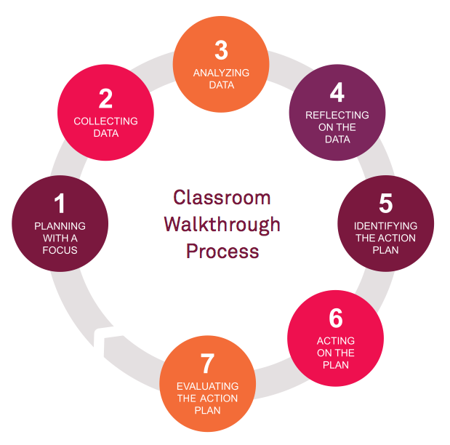
PLC PROCESS
TEACHSCAPE PROCESS
4
Analysis
5
Goals
6
Individual students
3
Common Assessment
2
Instruction Practice
1
Questions
Based on Data
Professional Learning Communities

Slide 15

Opportunities through PLCs - ELA
Unpacking Standards
Analysis = Potential Growth
Common Assessments
Develop a Common Language
Meeting the Needs of All Learners
Unit Planning and Curriculum Mapping
unpack-82474705451_xlarge.jpeg

Slide 16
Dream?
School
Regions
Executive
OCS
Parish
SC and PO
Teams
Principal

Slide 17
Tools
Professional Learning Communities at Work – Dufour and Dufour
Study/Discussion Guide for use in Regional Groups
Overview of the OCS – PD
Schools choose ELA leaders to attend the tool-kit training coming soon to a region near you

Slide 18
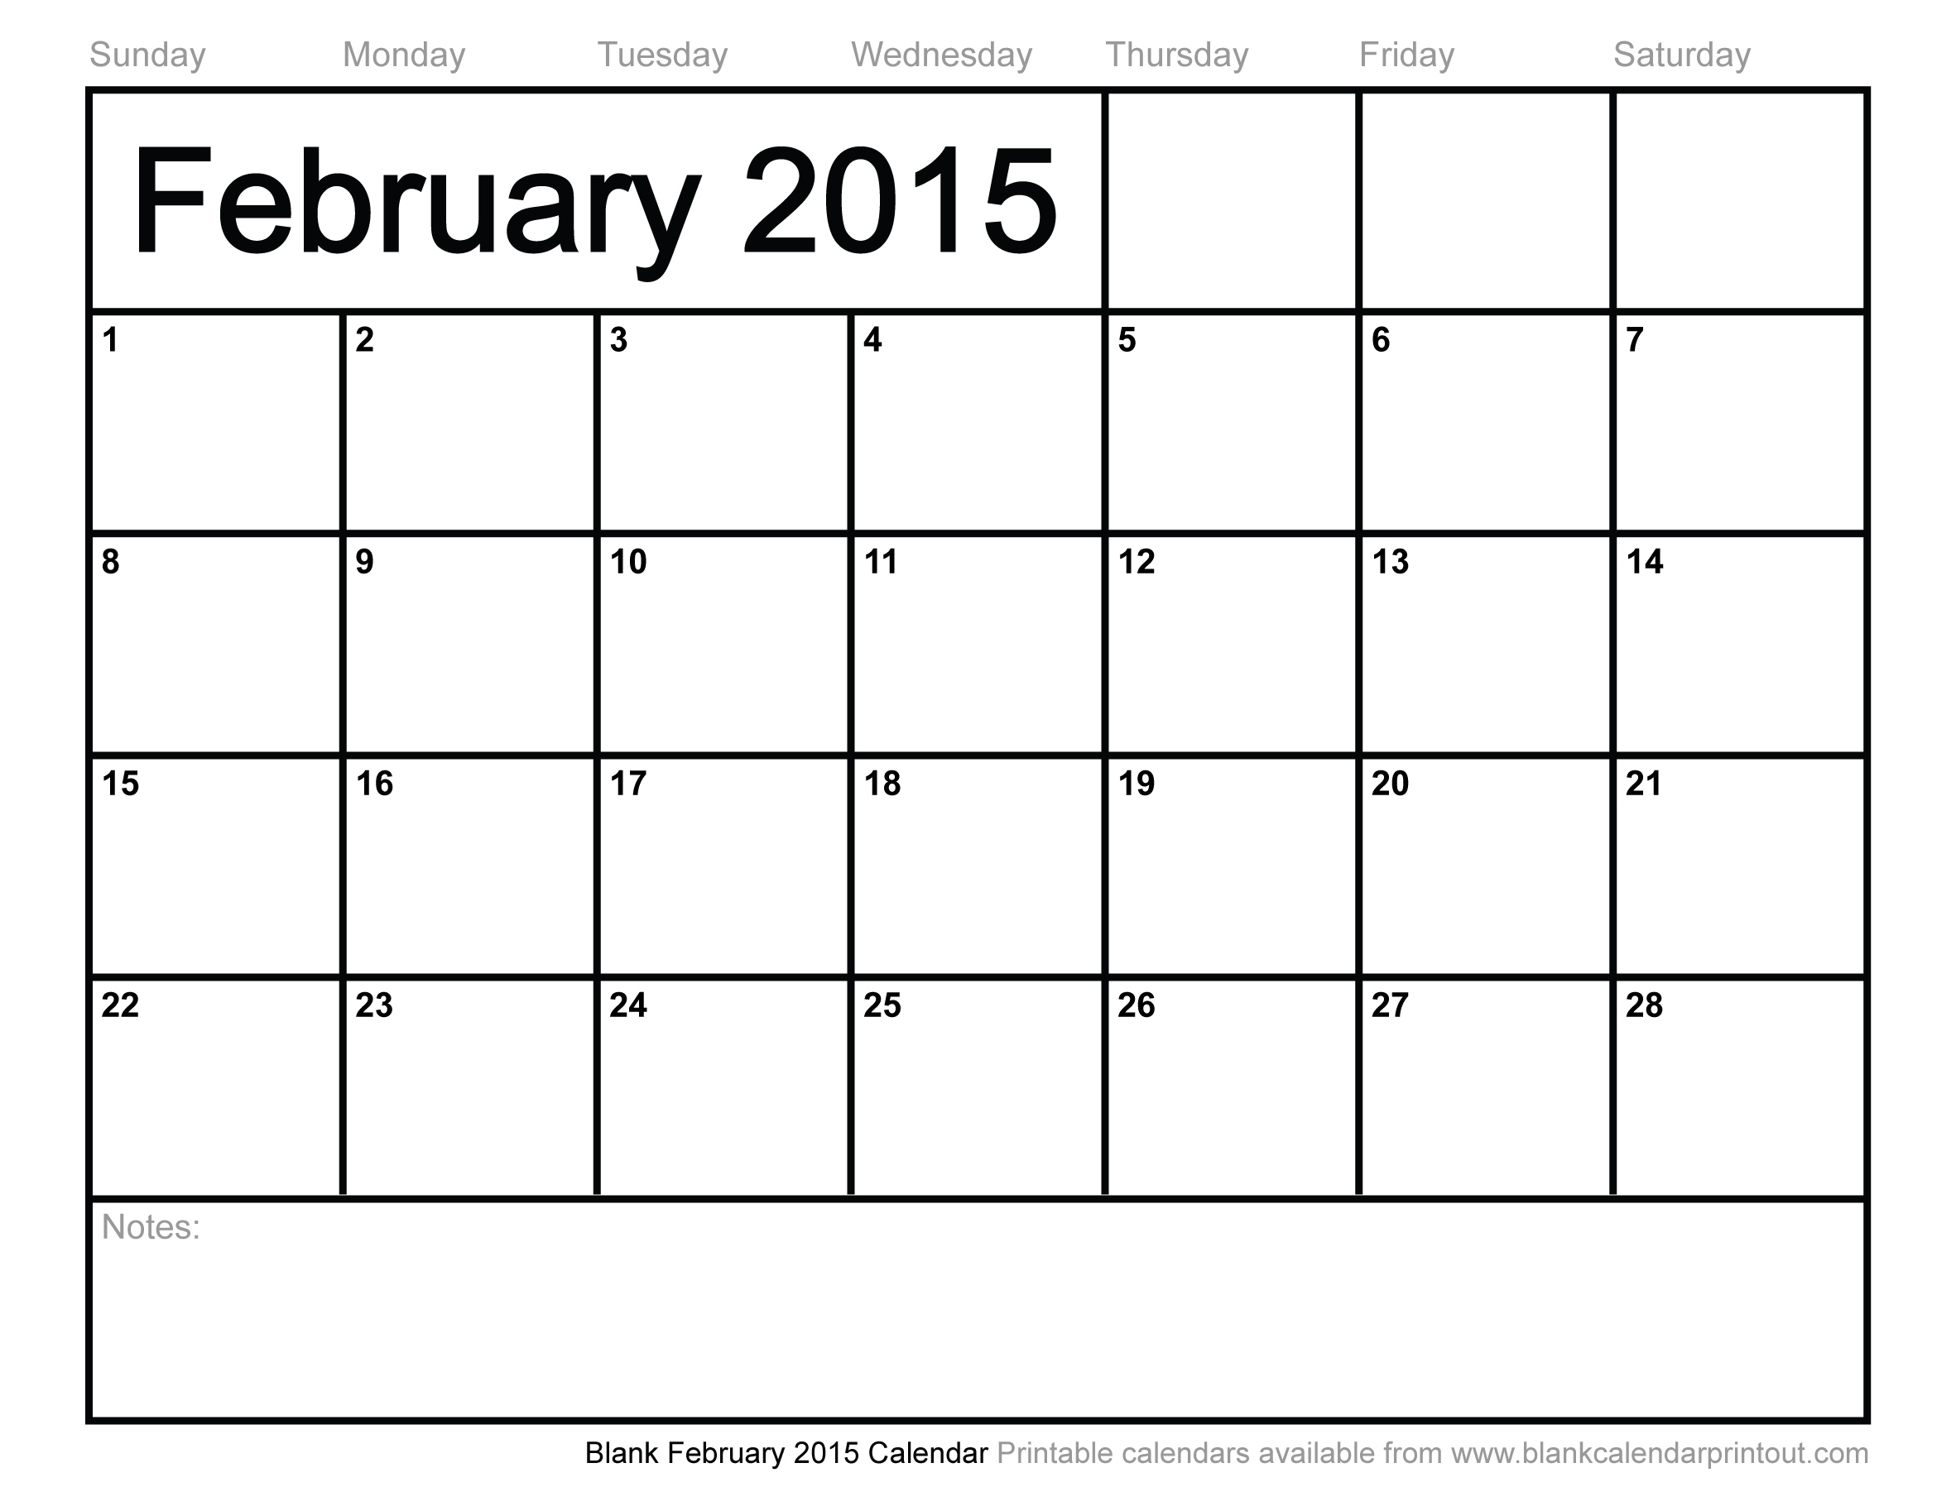
Ed Leadership Reg. Opens
Ed Lead. Reg. opens to other diocese
Title II funds may be used for Ed Leadership
Must apply to your school district as soon as registration opens to use funds for this year.

Slide 19

Professional Development
Teachscape Co-Hort III
ELA Training
Regional Development Day
Ed Lead. Registration Closes

Slide 20
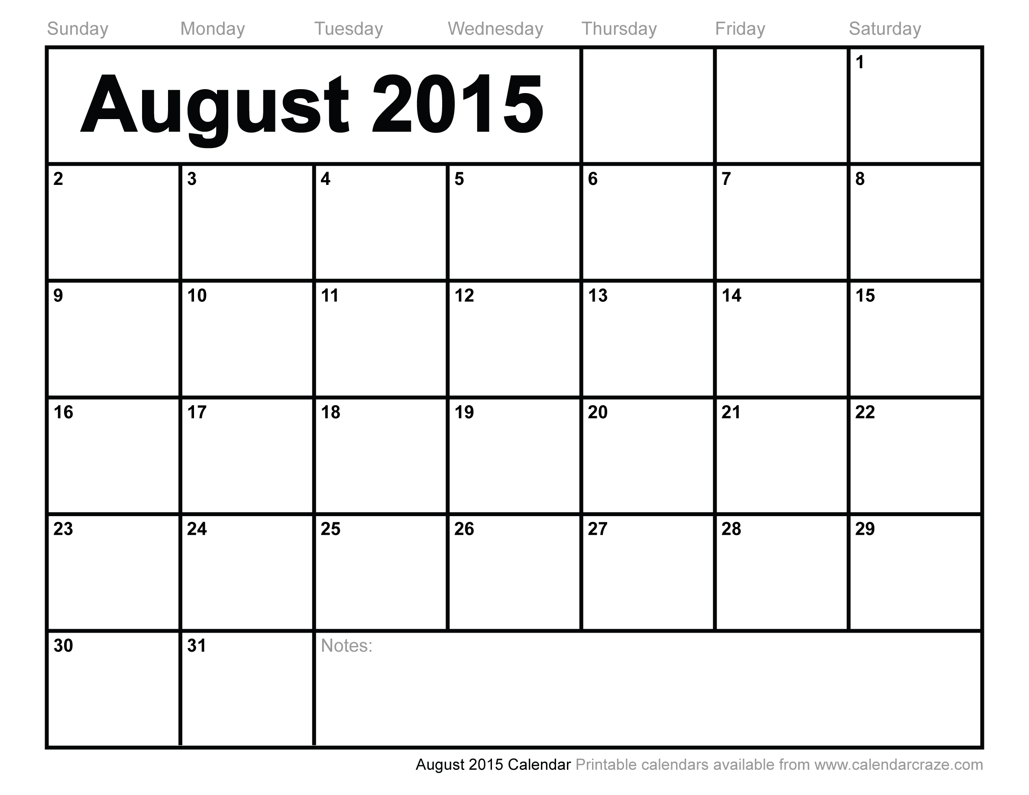
Professional Development
Kick-Start Topics
Systemic PLC’s and School PLC’s
Planning Professional Development for the Year
Preparing for the Accreditation Visit
Accreditation – just starting on the self-study
Parent Ambassadors – key programs that make the difference
Teachscape – how to and what to do with the data
Further along the road with the Indices of Vitality
How to complete the data packet
Hiring and Evaluating Process (Personnel Issues)
Principal
Kick-Start
TED Reg.
Ed. HR Edmonds
Ed. SM Olympia
Title II funds may be used for Ed Leadership
Must apply soon to use the current funds for this year

