Slide 1

PLC’s and Professional Development
Kick Start
Monday, August 11, 2015

Slide 2

Professional Development
School
Archdiocese
Region

Slide 3

Questions to start…
List the attributes of great professional development. “Very…”
What do you believe to be the best format for PD?
What is the relationship between professional development and professional learning community?
Using the Net Promoter Score, how likely are you to recommend your staff meetings as professional development to other principals? Why?
Detractors |  |  |  |  |  | Passive |  | Promoters
1 | 2 | 3 | 4 | 5 | 6 | 7 | 8 | 9 | 10
not likely at all neutral extremely likely

Slide 4
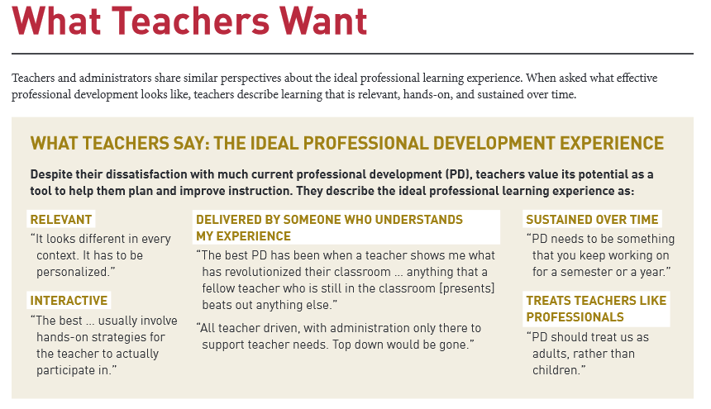

Attributes… “Teachers Know Best”, March 2014, Bill and Melinda Gates Foundation
“Teachers Know Best”, March 2014, Bill and Melinda Gates Foundation
Notes:
4,600 teachers in traditional schools took an on-line survey
30 educators in tech forward school interview and observed
54 educators traditional schools interviewed and observed

Slide 5

PD and PLC’s
Professional Development
Professional Learning Communities
Relevant
Interactive
Someone who understands
Sustained over time
Treat as a professional
Data driven
Determining goals
Working with colleagues
On-going throughout the year
Identifying best practices based on data
School
Archdiocese
Region

Slide 6
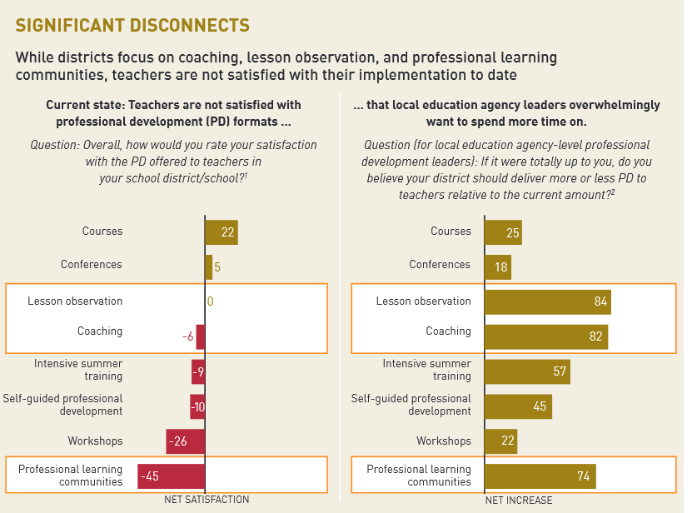
PD Format
Not satisfied
Want more!
Not satisfied
Want more!
“Teachers Know Best”, March 2014, Bill and Melinda Gates Foundation

Slide 7

OCS – Commitment to model
Professional Development
OCS Staff
Relevant
Interactive
Someone who understands
Sustained over time
Treat as a professional
Read, discuss, apply
Determining strategies for OCS, EP, Regions
Working with colleagues, Dr. Abelein
Actual work for 2 years to build and sustain
Identifying best practices based on data
School
Archdiocese
Region

Slide 8

Systemic PLCs PD Outcomes
Read and discuss Cultures Built to Last: Systemic PLCs at Work by Dufour and Fullan.
Application of systemic PLCs case studies to the current work of the strategic plan.
Process and use systemic PLC vocabulary and concepts in conversations with colleagues.
Discern application of systemic PLC concepts and transfer to Regional Principal PLCs.
Develop group leadership skills in order to satisfy the needs of each regional PLC.
School
Archdiocese
Region

Slide 9
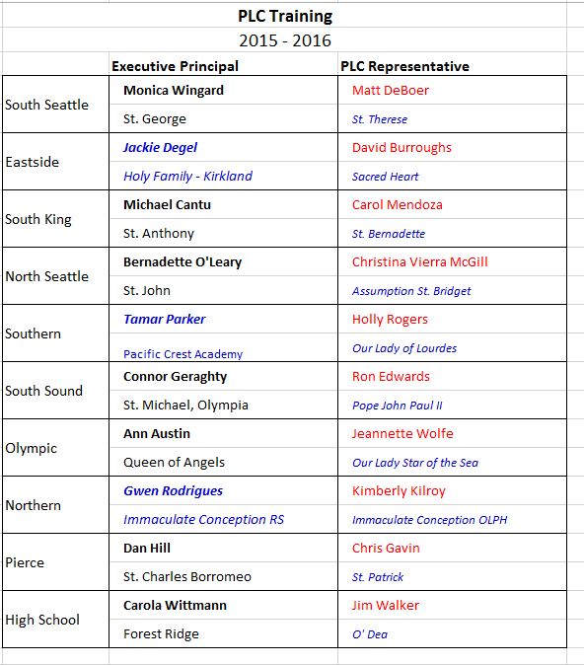

Executive Principals
PLC Representatives
2015-2016
School
Archdiocese
Region

Slide 10
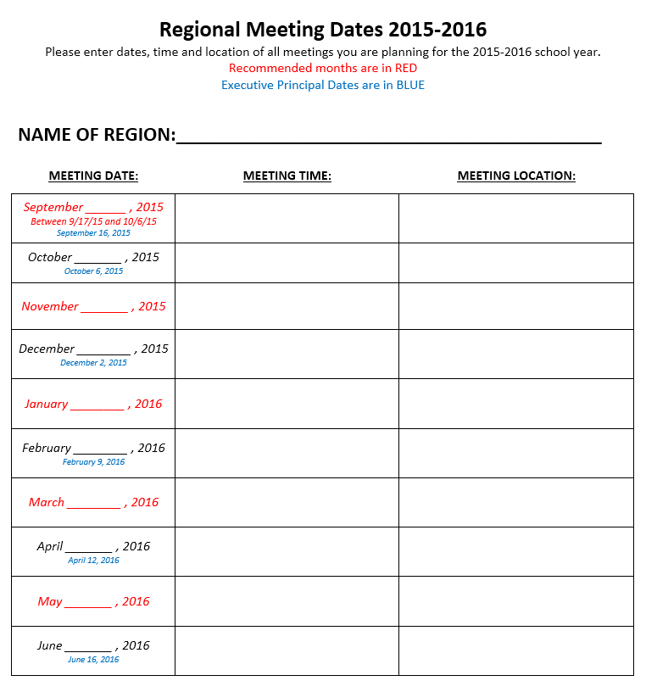
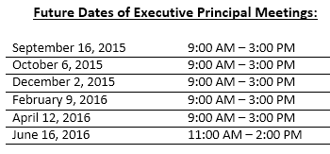


Slide 11






Where to go for the PD?
School
Archdiocese
Region

Slide 12

Strategic Plan and Accreditation Goals
Goal 1: Strengthening Catholic Identity
Goal 2: Excellent Curricula, Teachers, and School Leaders
Implement Archdiocesan Religion Standards and grade level assessments
Increase meaningful and intentional Service and Missionary Discipleship.
Complete K-8 Curriculum Mapping for all subjects in the next 5 years.
Increase effectiveness in the use of data to improve student learning with attention given to students in the 1st and 4th quartiles.

Slide 13
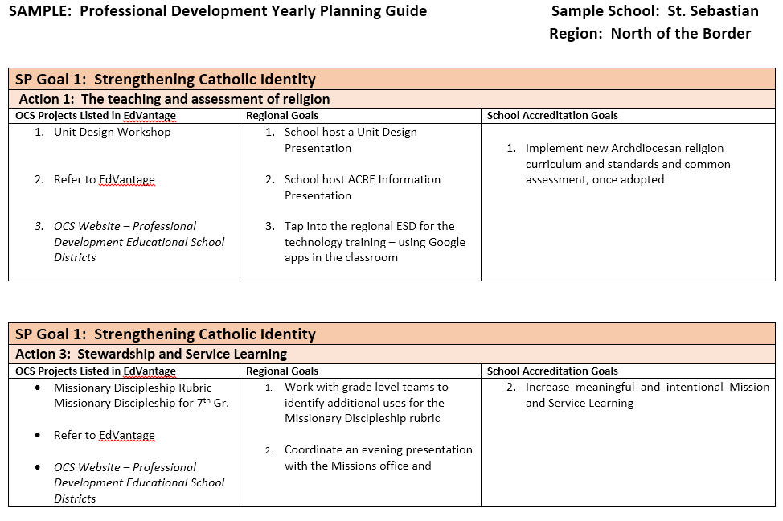

Slide 14
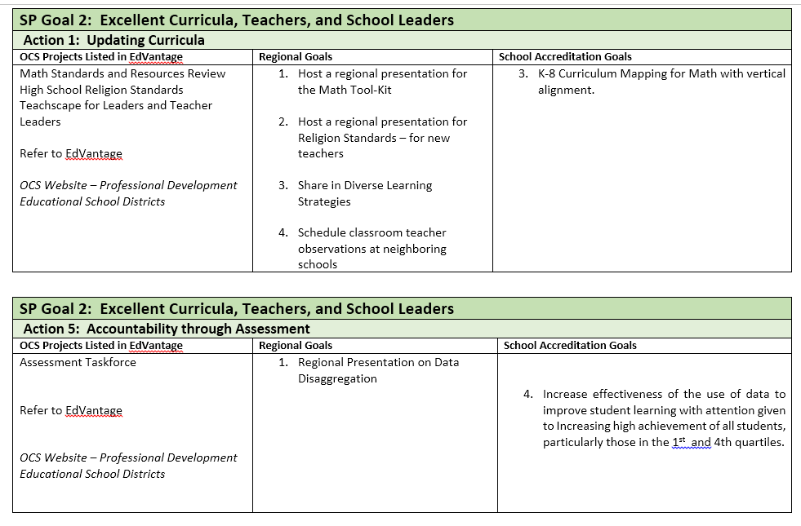

Slide 15
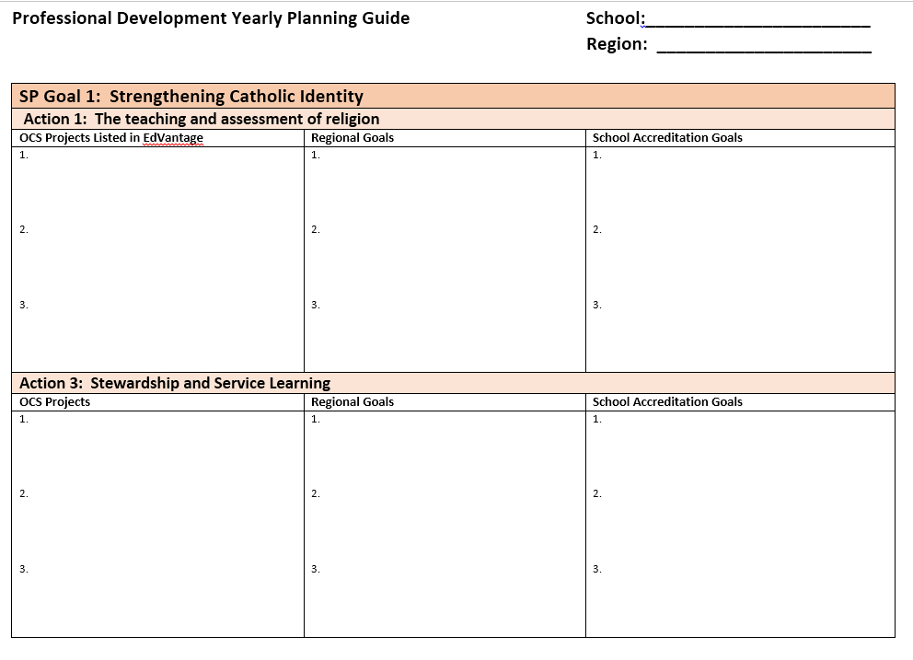

Slide 16
Regional Professional Development
Meet with the Region Principals
Discussion of respective accreditation goals
What are the common goals?
What resources from the OCS could we engage? From the local ESD?
March 18, 2016, Regional Professional Development Day Regions may apply for funds up to $2,500. Application will include:
  the topic,
  name of the facilitator,
  proposed content,
  schedule and activities
  the budget for the day

Slide 17
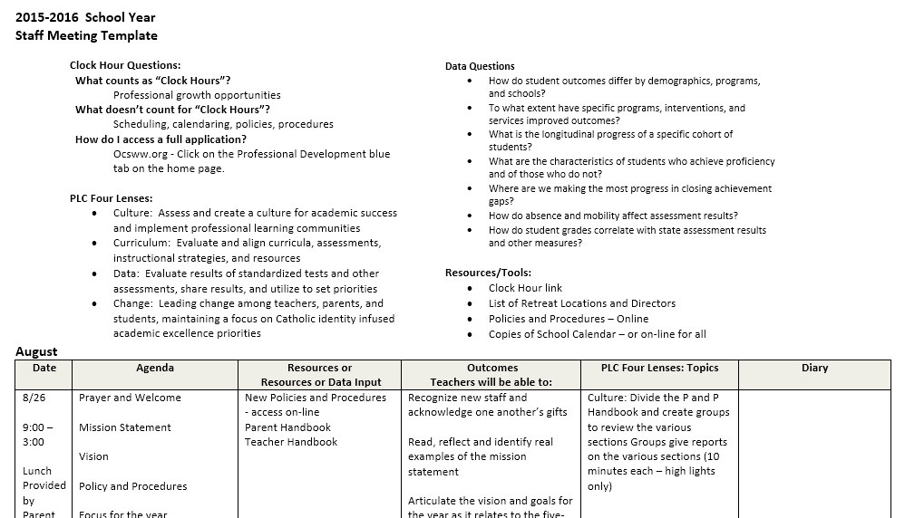
School Professional Development
School
Archdiocese
Region

Slide 18
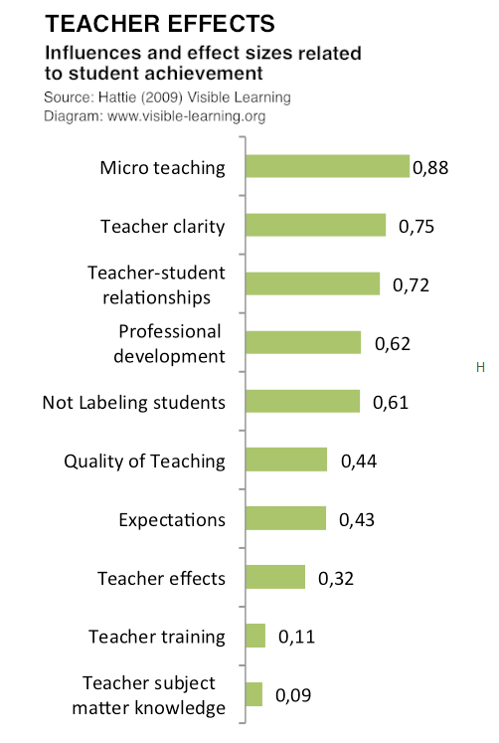
Research - what works….
http://visible-learning.org/2015/06/download-john-hattie-politics-distraction/
Micro teaching – a video recording and review (Teaching Channel)
Teacher clarity – clearly communicate the intentions of the lesson and the success criteria (targets)

Slide 19

Quickly…
What’s bad? Retention, summer holidays
What’s neither bad nor good? Team teaching, open vs. traditional classes
What helps a bit? Class size, homework
What helps a bit more? Cooperative learning, direct instruction
What helps a lot? Feedback, Student-teacher relationships
Visible Learning Meta-Study, John Hattie, 2009

Slide 20
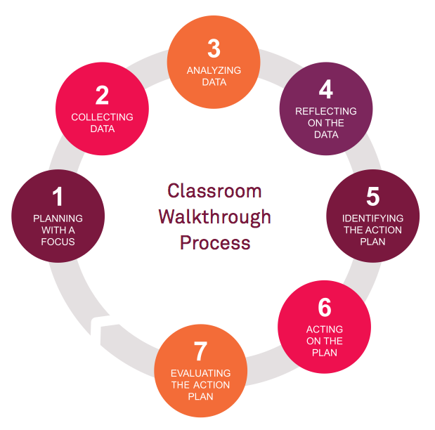

Teachscape Possibilities
A look at the elementary data
1,162 walk-throughs
From the data selected, what is the story, and what could we work on as a staff?

Slide 21
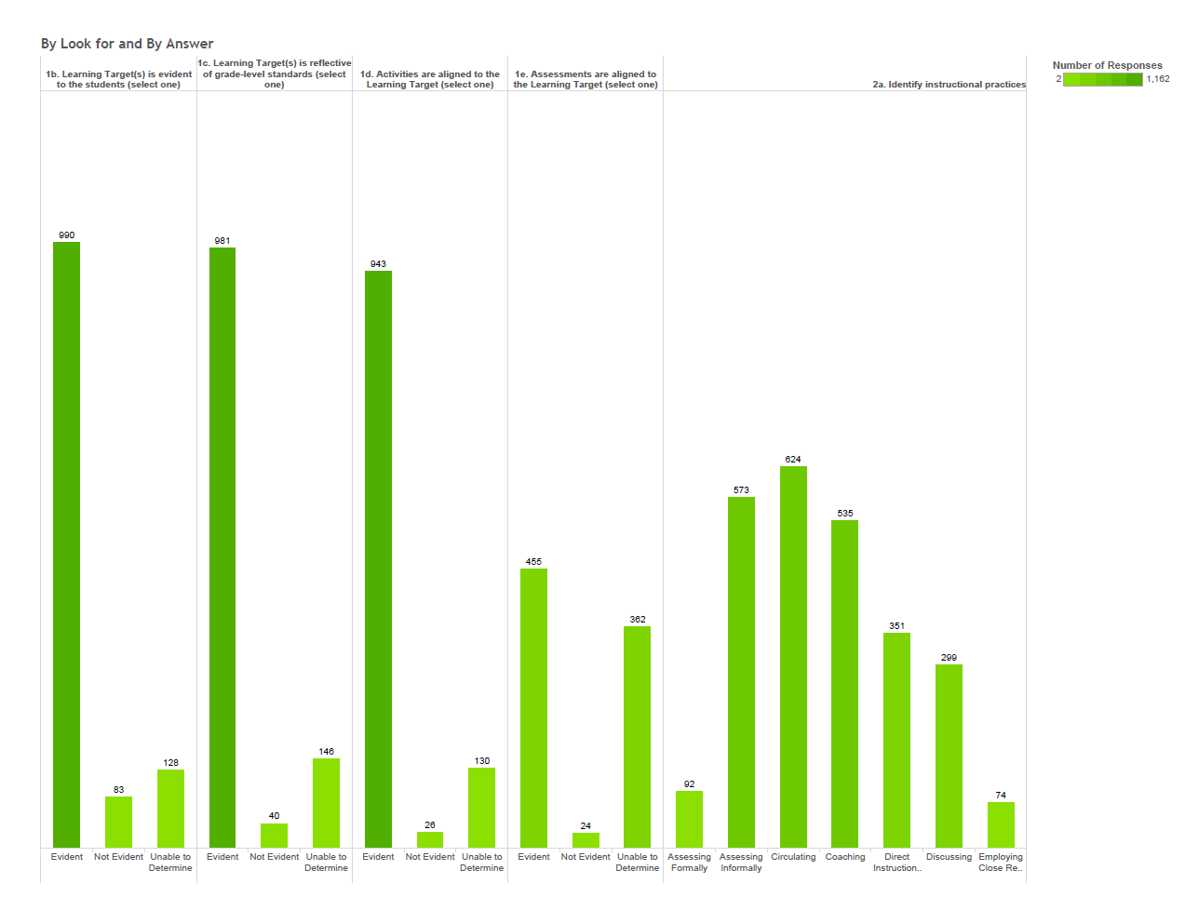
53% –circulating
85% – targets evident to students
39% - assessments aligned
6% – close reading

Slide 22
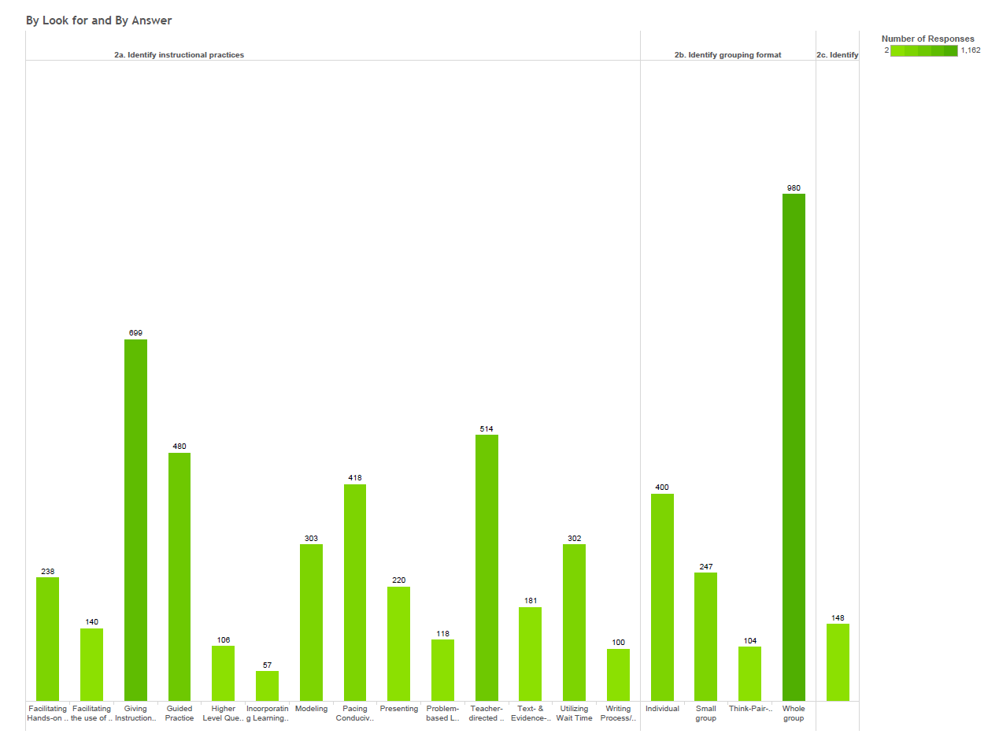

86% whole group
9% - higher level questions
60% –giving directions

Slide 23
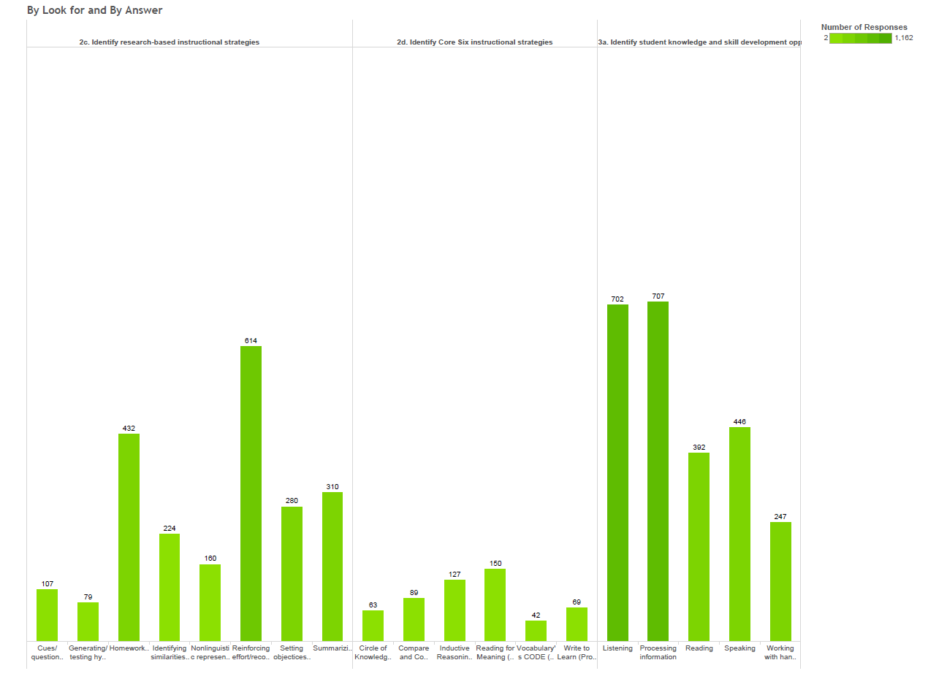

52% - reinforce effort
65% listening
38% writing or speaking.
7% teachers employing Core 6 Instructional Strategies

Slide 24
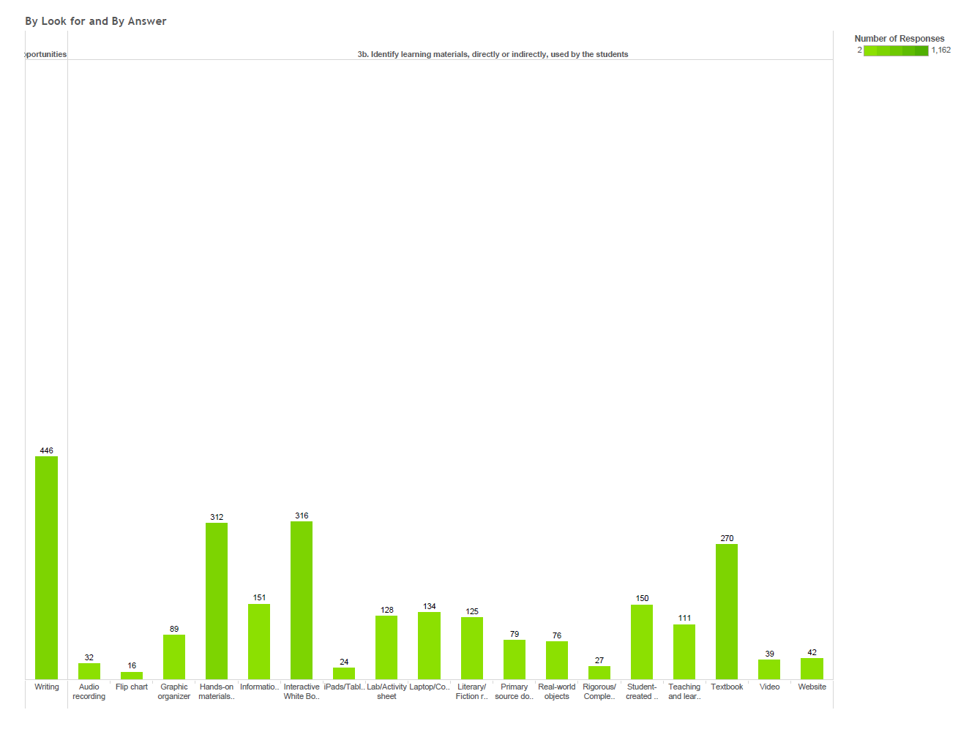
27% interactive white boards
23% use of textbooks – more than any resource
2% use of iPads

Slide 25
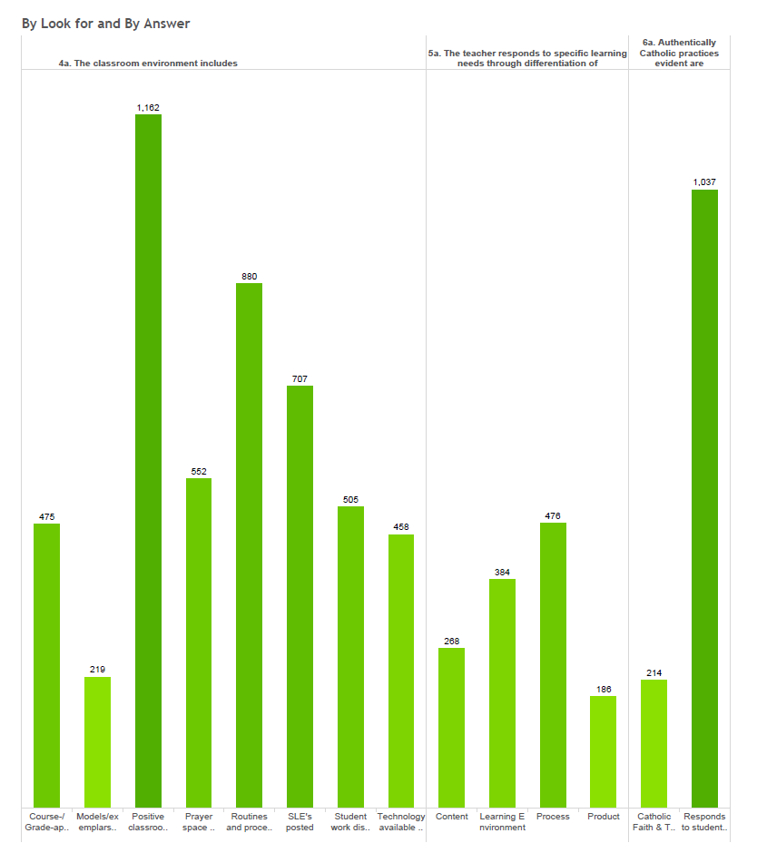
19% - integrating Catholic Faith and Tradition
100% - positive classrooms
89% - responding to students with respect, dignity and compassion

Slide 26
How to use this information for growth?
Of those observed, and if the criteria was used the following goals could be established: Specific, Measureable, Attainable, Realistic, Timebound
Teachers in the Archdiocese of Seattle will be able to use the research based Core 6 Strategies by 20% by spring 2016

Slide 27
Formation vs. Evaluation
How do we use the information?
Use of the EIE – Essential Instructional Evaluation

